Slide 1

Day 4
Java 8
By
Shalini Mittal

Slide 2
Journey Continued……
Base 64
Scripiting Engine
New Memory Space – Metaspace
Executor

Slide 3
Base 64
Base 64 encoding convert your binary data into 64 printable ASCII characters
The support of Base64 encoding has made its way into Java standard library with Java 8 release
Java.util.Base64 has mostly static methods for encoding and decoding
No need for external dependencies like sun or apache commons
Base64.Encoder - encoding byte data using the Base64 encoding scheme as specified in RFC 4648 and RFC 2045.
Base64.Decoder - decoding byte data using the Base64 encoding scheme as specified in RFC 4648 and RFC 2045.
Notes:
When you have some binary data that you want to ship across a network, you generally don’t do it by just converting data into stream of bits and bytes over the network in a raw format. Why? because some media are designed for streaming text only. These protocols may interpret your binary data as control characters which they are not.

Slide 4
JavaScript Engine
Bidges the gap between handy little scripting languages and the robust Java ecosystem
Embed any scripting language with your Java code
Rhino scripting engine – java 6
Nashorn scripting engine – java 8
Notes:
Nashorn supports the full ECMAScript 5.1 specification plus some extensions. It compiles JavaScript to Java bytecode using new language features based on JSR 292, including invokedynamic, that were introduced in JDK 7.of methods

Slide 5
Nashorn
Performance and memory usage better than Rhino
Nashorn supports the full ECMAScript 5.1 specification plus some extensions
Compiles JavaScript to Java bytecode using new language features based on JSR 292, including invokedynamic
2 to 10x performance boost over the former Rhino implementation
Support for functional interfaces
Supports javax.script package
Support for invoking Java code from JavaScript and for Java to invoke JavaScript code(direct mapping to JavaBeans)
Nashorn defines a new command-line tool, jjs, for evaluating JavaScript code

Slide 6
Shell Script
To invoke the Nashorn engine from the command line
Pass the name of a JavaScript file you want executed
Replacemement for shell script
REPL (read-execute-print-loop command-line) environment for JavaScript here.
Available under path –
C:\......\jdk1.8.0_20\bin\jjs

Slide 7
Passing data to and from Java
ScriptEngineManager scriptEngineManager = new ScriptEngineManager();
ScriptEngine nashorn = scriptEngineManager.getEngineByName("nashorn");
String name = "Olli";
nashorn.eval("print('" + name + "')");

Slide 8
PermGen – Permanent Generation
Contains information about classes, such as bytecode, names and JIT information
Stored in a separate space, because it is mostly static and garbage collection can be much more optimized by separating it.
Problems:
System showing "java.lang.OutOfMemoryError
Often caused by a memory leak related to classloaders, and creation of new classloaders, which generally happens during hot deployments of code
Most common "problem" is that the default value 64MB is way too low.
Setting it to 256MB is the usual band aid to resolve it.
Solution:
Need a new memory space
Memory sizing – Ohhh!! I don’t want to worry about
Notes:
Streams are consumable, so there is no way to create a reference to stream for future usage. Since the data is on-demand, it’s not possible to reuse the same stream multiple times

Slide 9
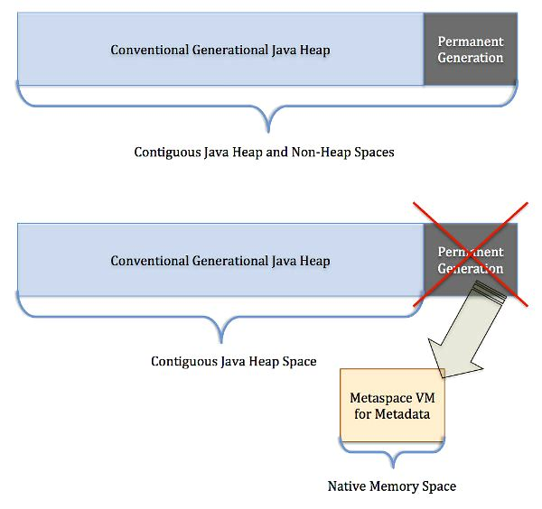
A new memory space is born - Metaspace
Notes:
similar to the Oracle JRockit and IBM JVM's.

Slide 10
How will it assist??
Class metadata allocated out of native memory
Max available space is the total available system memory
Notes:
similar to the Oracle JRockit and IBM JVM's.

Slide 11
Metaspace
JDK 8 HotSpot JVM uses native memory for the representation of class metadata
No more java.lang.OutOfMemoryError: PermGen space problems
No need to tune and monitor this memory space anymore
PermGen memory space is completely removed.
PermSize and MaxPermSize JVM arguments are ignored and a warning is issued if present at start-up.
Metaspace memory allocation model
Most allocations for the class metadata are now allocated out of native memory.
The klasses that were used to describe class metadata have been removed.
Notes:
similar to the Oracle JRockit and IBM JVM's.

Slide 12
Metaspace capacity
Default - class metadata allocation limited by the amount of available native memory (capacity depends on 32-bit JVM vs. 64-bit along with OS virtual memory availability).
Limit the amount of native memory used for class metadata
-XX:MaxMetaspaceSize=128m
Flag not specified - Metaspace dynamically re-sizes depending if application demands at runtime.

Slide 13
Metaspace garbage collection
Dead classes and classloaders GC is triggered once the class metadata usage reaches the “MaxMetaspaceSize”.
Proper monitoring & tuning of the Metaspace still required in order to limit the frequency or delay of such garbage collections.
Excessive Metaspace garbage collections may be a symptom of classes, classloaders memory leak or inadequate sizing for your application.

Slide 14
Garbage Collectors
Serial Collector
Single Threaded environment
Freezes all application threads
JVM argument - XX:+UseSerialGC
Parallel/Throughput Collector
Default collector
Multiple threads to compact heap
Stops application thread
For apps that can tolerate application pauses and optimize for lower CPU
Notes:
best suited for apps that can tolerate application pauses and are trying to optimize for lower CPU overhead caused by the collector.
3. The

Slide 15
Garbage Collector Contd
CMS(Concurrent Mark-Sweep) Collector
Concurrent threads
Mark the heap for unused objects
Recycle(Sweep)
G1(Garbage First) Collecctor
Supports heap larger than 4GB
Scans those regions that contain the most garbage objects first
JVM Command - –XX:+UseG1GCflag
Compacts the heap on the Go
Java 8 and G1
String Deduplication(strings and chr[]
JVM argument - XX:+UseStringDeduplication

Slide 16
Concurrent Threads
Notes:
http://docs.oracle.com/javase/8/docs/api/java/util/concurrent/ExecutorService.html

Slide 17
ExecutorService
An Executor that provides methods to manage termination and methods that can produce a Future for tracking progress of one or more asynchronous tasks.
An ExecutorService can be shut down, which will cause it to reject new tasks. Two different methods are provided for shutting down an ExecutorService. The shutdown() method will allow previously submitted tasks to execute before terminating, while the shutdownNow() method prevents waiting tasks from starting and attempts to stop currently executing tasks. Upon termination, an executor has no tasks actively executing, no tasks awaiting execution, and no new tasks can be submitted. An unused ExecutorService should be shut down to allow reclamation of its resources.
Method submit extends base method Executor.execute(Runnable) by creating and returning a Future that can be used to cancel execution and/or wait for completion. Methods invokeAny and invokeAll perform the most commonly useful forms of bulk execution, executing a collection of tasks and then waiting for at least one, or all, to complete. (Class ExecutorCompletionService can be used to write customized variants of these methods.)
The Executors class provides factory methods for the executor services provided in this package.
Notes:
http://docs.oracle.com/javase/8/docs/api/java/util/concurrent/ExecutorService.html

Slide 18
Executor Factory
// Creates an Executor that uses a single worker thread operating off an unbounded queue.
ExecutorService es1 = Executors.newSingleThreadExecutor();
// Creates a thread pool that reuses a fixed number of threads operating off a shared unbounded queue.
ExecutorService es2 = Executors.newFixedThreadPool(10);
// Creates a thread pool that can schedule commands to run after a given delay, or to execute periodically.
ExecutorService es3 = Executors.newScheduledThreadPool(10);
Notes:
http://docs.oracle.com/javase/8/docs/api/java/util/concurrent/ExecutorService.html
http://howtodoinjava.com/java-7/forkjoin-framework-tutorial-forkjoinpool-example/

Slide 19
Ways to delegate Tasks
execute(Runnable)
submit(Runnable)
submit(Callable)
invokeAny(...)
invokeAll(...)
Notes:
http://docs.oracle.com/javase/8/docs/api/java/util/concurrent/ExecutorService.html

Slide 20
Execute()
The execute method takes a Runnable, and executes it asynchronously:
executorService.execute(new Runnable() {
public void run() {
System.out.println("A task");
}
});
executorService.shutdown();
Notes:
http://docs.oracle.com/javase/8/docs/api/java/util/concurrent/ExecutorService.html

Slide 21
Submit()
This method takes a Runnable but returns a Future object. This object returns null when the Runnable has finished executing:
Future future = executorService.submit(new Runnable() {
public void run() {
System.out.println("A task");
}
});
future.get(); //Blocks until the Runnable has finished
executorService.shutdown();
Notes:
http://docs.oracle.com/javase/8/docs/api/java/util/concurrent/ExecutorService.html

Slide 22
Submit(Callable)
This version of the method takes a Callable, and returns a Future object with a result when it has finished executing:
Future future = executorService.submit(new Callable<String>() {
public String call() {
return "A callable";
}
});
System.out.println(future.get()); //Blocks until the Callable has finished
executorService.shutdown();
Notes:
http://docs.oracle.com/javase/8/docs/api/java/util/concurrent/ExecutorService.html

Slide 23
Futures and Callables
The executor frameworker uses Runnable objects. Unfortunately a Runnable cannot return a result to the caller.
In case you expect your threads to return a computed result you can use java.util.concurrent.Callable. The Callable object allows to return values after completion.
The Callable object uses generics to define the type of object which is returned.
If you submit a Callable object to an Executor, the framework returns an object of type java.util.concurrent.Future. Future exposes methods allowing a client to monitor the progress of a task being executed by a different thread. Therefore, a Future object can be used to check the status of a Callable. It can also be used to retrieve the result from the Callable.
Notes:
http://docs.oracle.com/javase/8/docs/api/java/util/concurrent/ExecutorService.html

Slide 24
Fork/Join Framework
designed for work that can be broken down into smaller tasks, with its results combined to produce the final result. One important concept is that ideally no worker thread is idle, idle workers steal the work from those workers who are busy, this is known as work-stealing.
if (problem is small)
directly solve problem
else {
split problem into independent parts
fork new subtasks to solve each part
join all subtasks
compose result from subresults
}
The core classes of the Fork-Join framework are ForkJoinPool and ForkJoinTask.
Notes:
http://docs.oracle.com/javase/8/docs/api/java/util/concurrent/ExecutorService.html

Slide 25
ForkJoinPool
ForkJoinPool is an implementation of ExecutorService that employs the work-stealing algorithm. It can be created like this:
ForkJoinPool pool = new ForkJoinPool(int); //creates a ForkJoinPool with the indicated parallelism level (number of initial threads in the pool)
ForkJoinPool pool = new ForkJoinPool(); //equivalent to new ForkJoinPool(Runtime.Available Processors()) There are different ways of submitting a task to the ForkJoinPool:
void execute(ForkJoinTask<?> task) //Arranges for (asynchronous) execution of the given task.
void execute(Runnable task) //Executes the given command at some time in the future.
<T> T invoke(ForkJoinTask<T> task) //Performs the given task, returning its result upon completion.
<T> List<Future<T>> invokeAll(Collection<? extends Callable<T>> tasks) Executes the given tasks, returning a list of Futures holding their status and results when all complete.
<T> ForkJoinTask<T> submit(Callable<T> task) Submits a value-returning task for execution and returns a Future representing the pending results of the task.
<T> ForkJoinTask<T> submit(ForkJoinTask<T> task) //Submits a ForkJoinTask for execution.
ForkJoinTask<?> submit(Runnable task) Submits a Runnable task for execution and returns a Future representing that task.
<T> ForkJoinTask<T> submit(Runnable task, T result) Submits a Runnable task for execution and returns a Future representing that task.
Notes:
http://docs.oracle.com/javase/8/docs/api/java/util/concurrent/ExecutorService.html

Slide 26
ForkJoinTask
ForkJoinTask is an abstract class for creating tasks that run within a ForkJoinPool. RecursiveAction and RecursiveTask are its subclasses. The only difference between these two classes is that the RecursiveAction does not return a value while RecursiveTask does.
The main methods of ForkJoinTask are:
The fork() method allows a ForkJoinTask to be planned for asynchronous execution. A new task can be created with this method.
The join() method allows a ForkJoinTask to wait for the completion of another one.
In this example, the program finds the minimum number from a large array:
Notes:
http://docs.oracle.com/javase/8/docs/api/java/util/concurrent/ExecutorService.html

Slide 27

Any Question ?

Slide 28
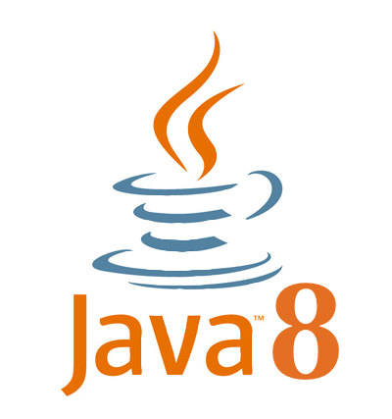
Thank you !

